Slide 1
Joining up digital services and resources for
Research Infrastructures: perspectives from the
Social Sciences and Humanities
Sally Chambers - DARIAH-EU, Ghent Centre for Digital Humanities
KBR, Royal Library of Belgium and the British Library

Slide 2
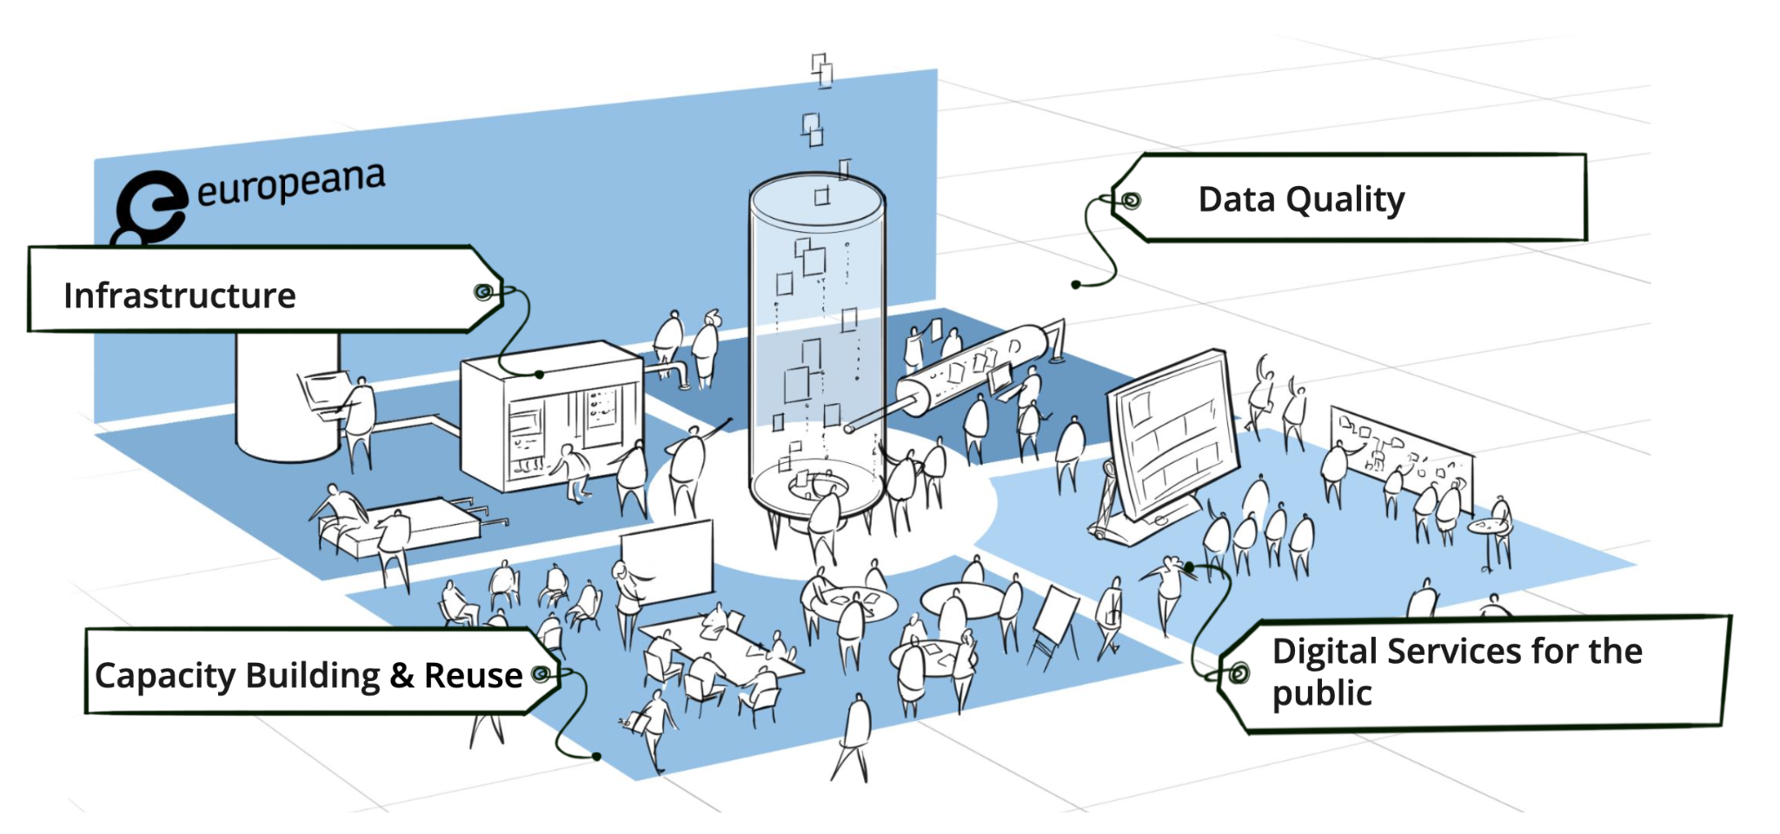
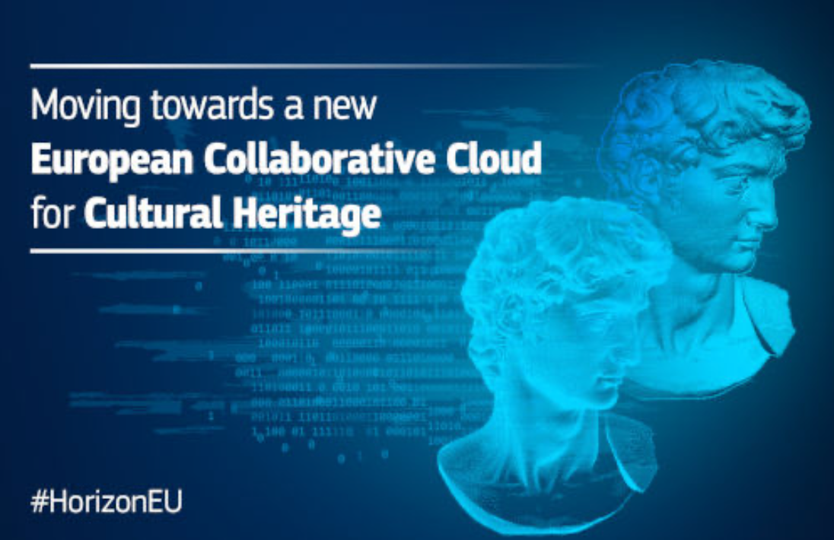
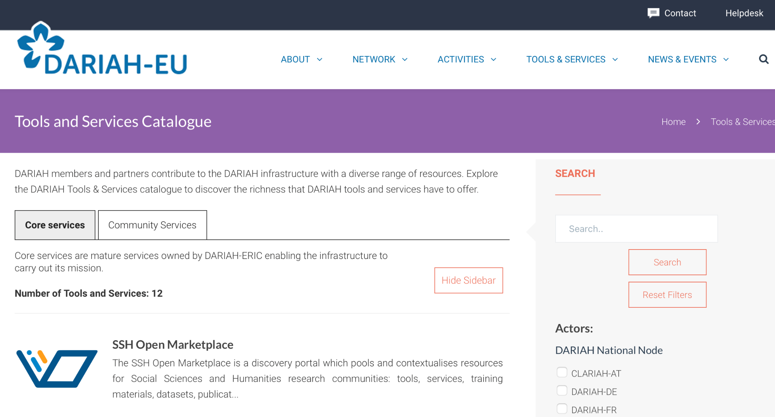
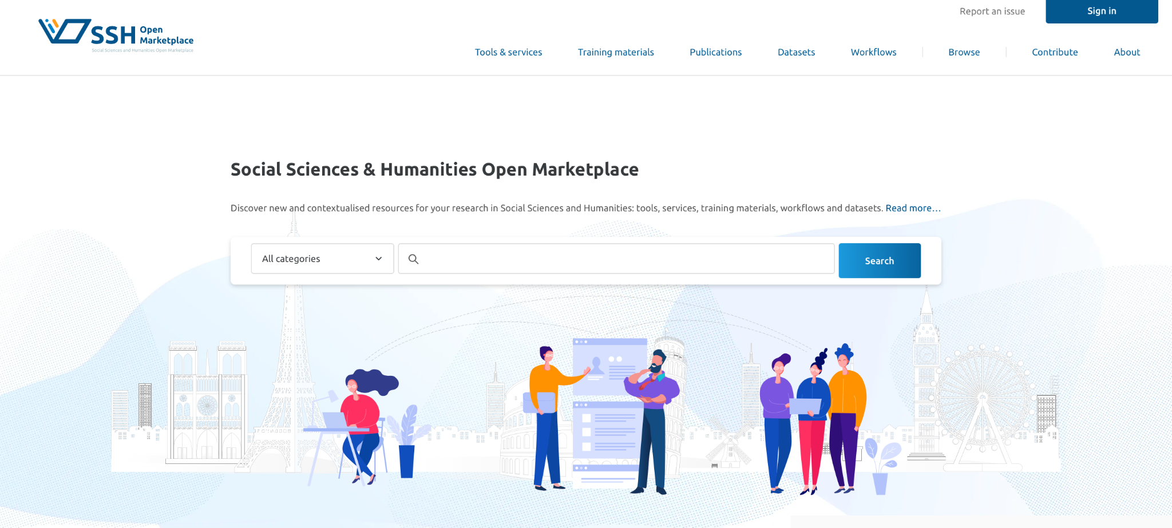
The Research Infrastructures landscape is increasingly complex
Role: Interoperable Data Aggregation (beyond metadata)
Role: State of the Art processing of Cultural Heritage Data (e.g AI-based)
Role: Publishing of tools; methods and derived datasets for reuse

Slide 3
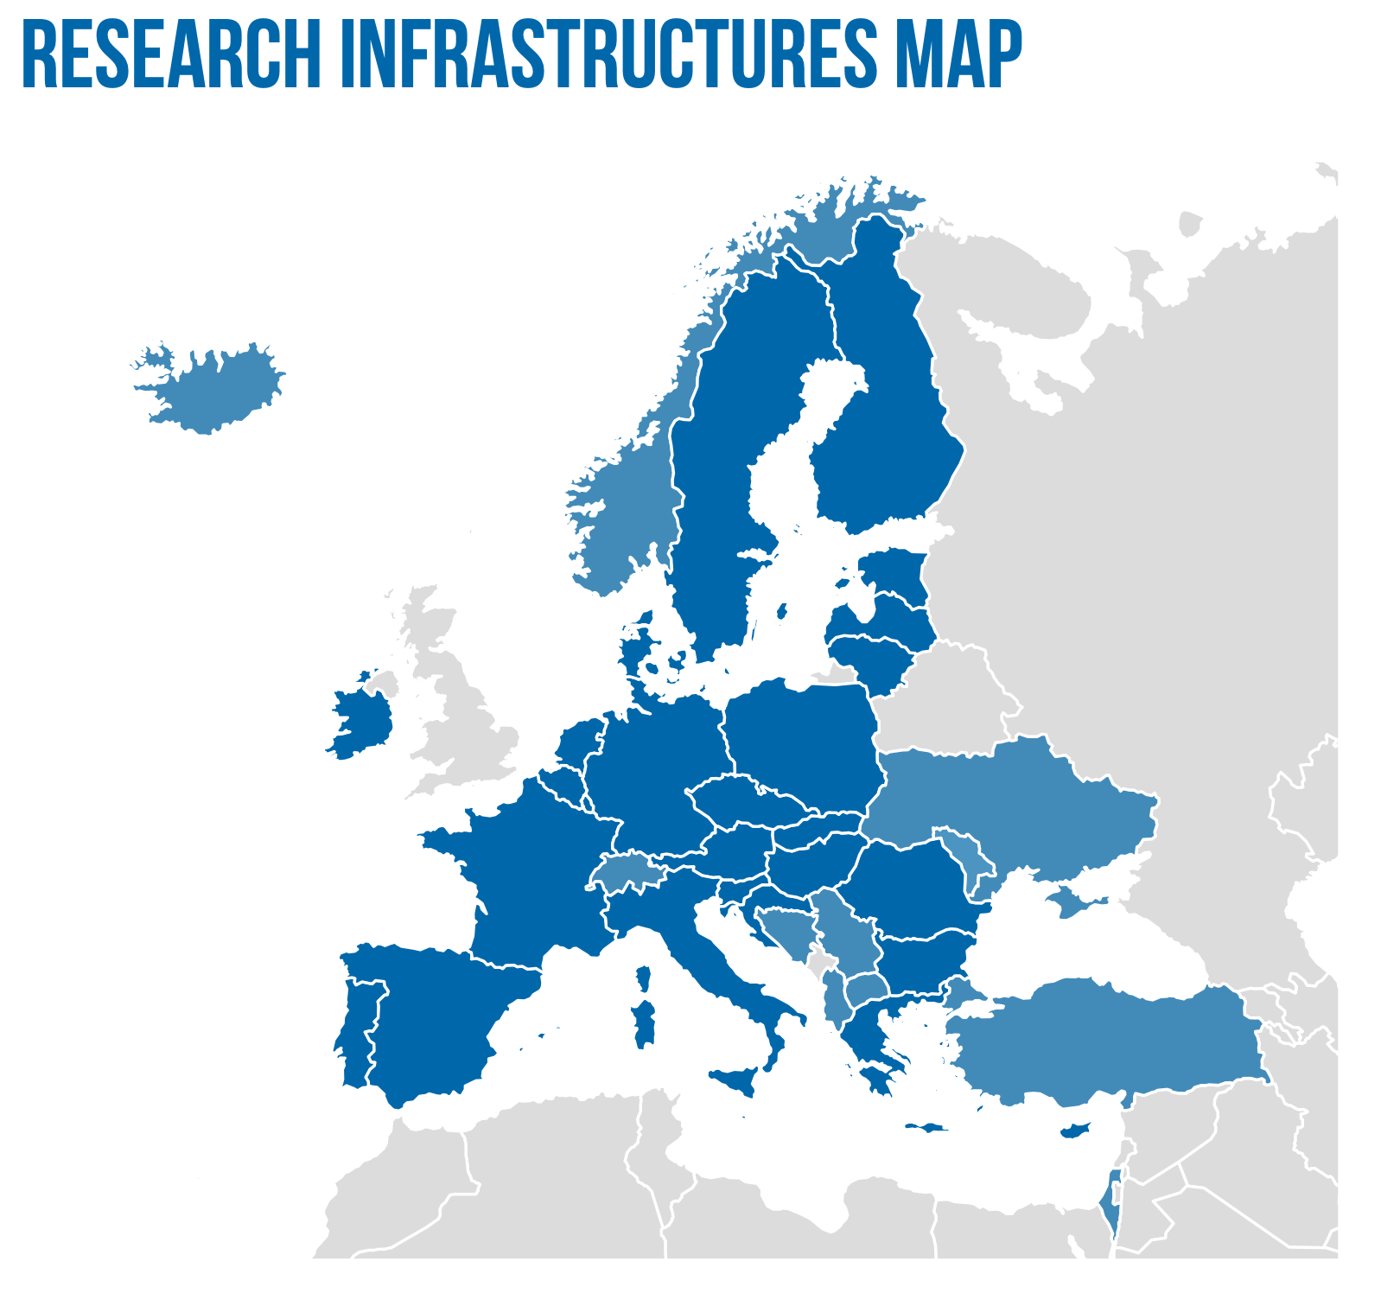
ESFRI Research Infrastructure Landscape
63 ESFRI Research Infrastructures
41 Landmark Infrastructures (Operational)
22 Emerging Infrastructures (Projects)
https://roadmap2021.esfri.eu/projects-and-landmarks/explore-the-map/

Slide 4
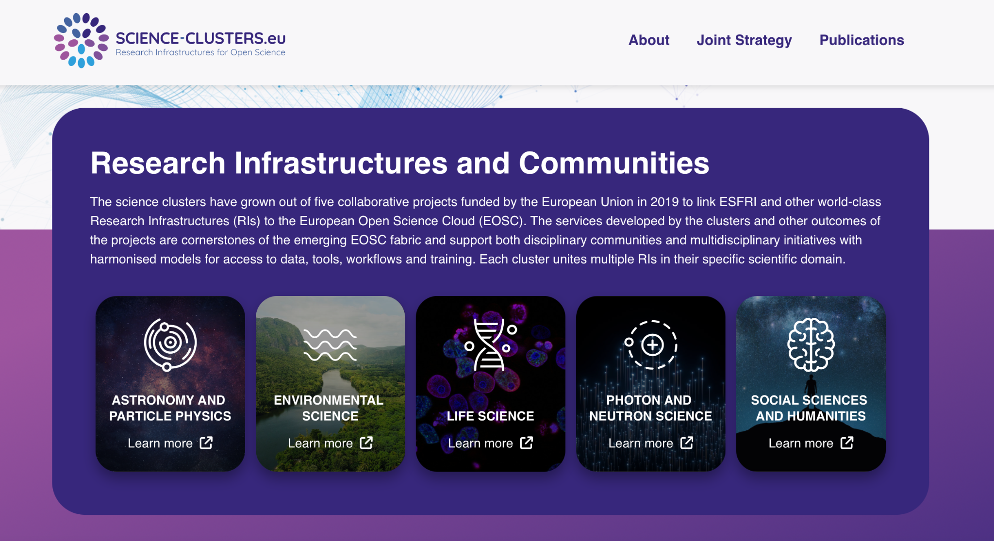
Fostering the uptake of Open Science in Europe
OSCARS brings together world-class European Research Infrastructures (RIs) in the ESFRI roadmap and beyond to foster the uptake of Open Science in Europe.
Joining the RIs and their communities through the Science Clusters
The Science Clusters are an integral part of the European Open Science Cloud (EOSC) initiative
https://science-clusters.eu/
https://oscars-project.eu/

Slide 5
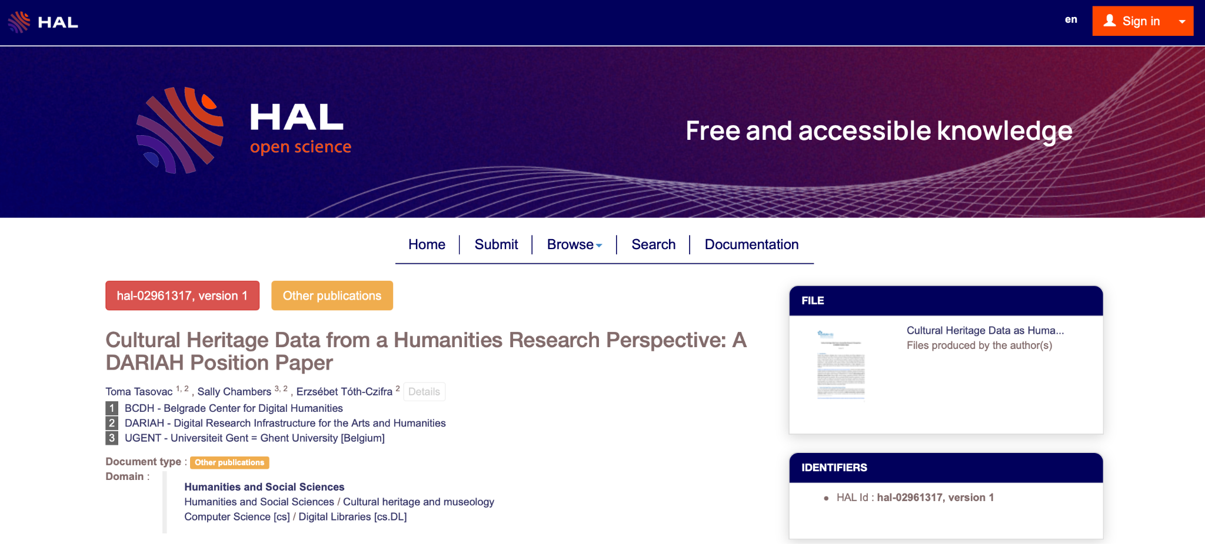
Cultural Heritage Data as Humanities Research Data
Tasovac, T., Chambers, S. and Tóth-Czifra, E. (2020) Cultural Heritage Data from a Humanities Research Perspective: A DARIAH Position Paper. https://hal.archives-ouvertes.fr/hal-02961317

Slide 6
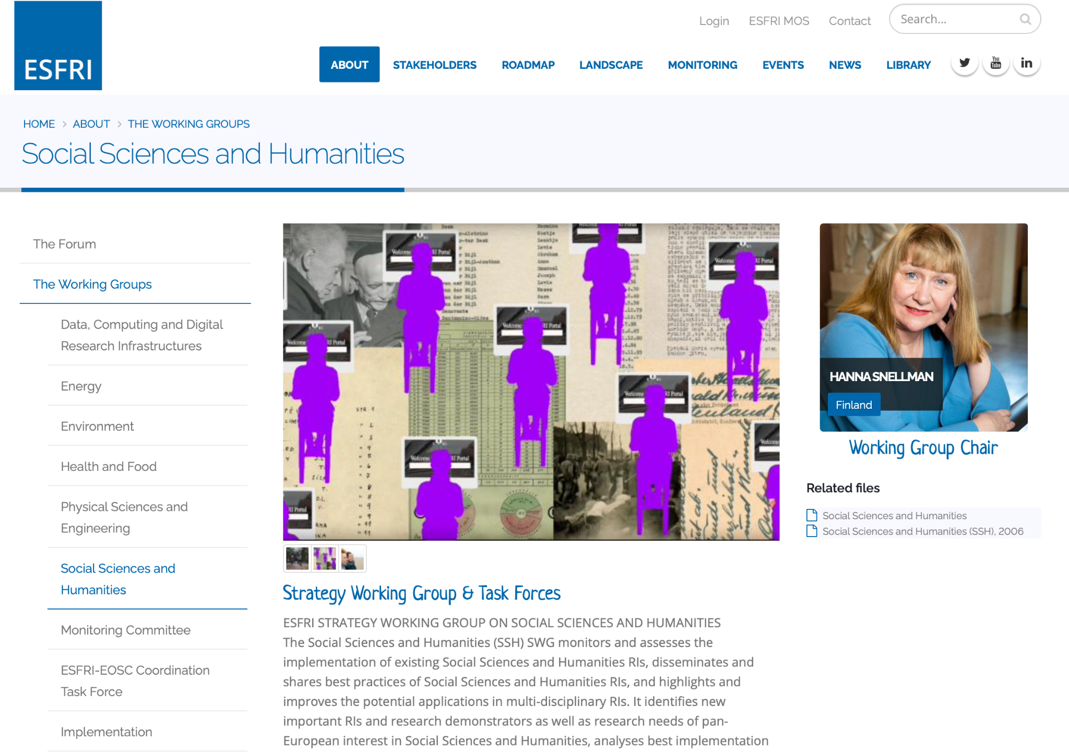
Joining up with the ESFRI Strategy Working Groups
https://www.esfri.eu/working-groups/social-sciences-and-humanities

Slide 7
Common European data space for cultural heritage
https://www.dataspace-culturalheritage.eu/en

Slide 8
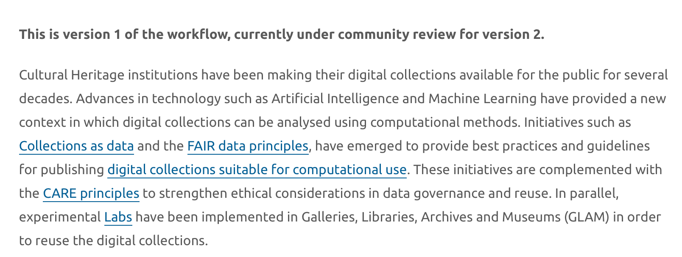
A Collections as Data workflow in the SSH Open Marketplace
https://marketplace.sshopencloud.eu/workflow/I3JvP6

Slide 9
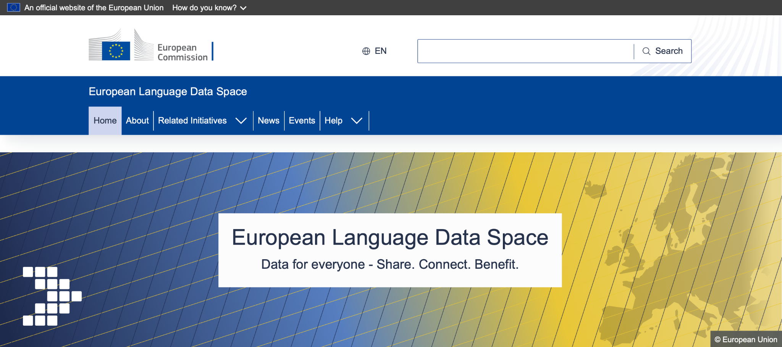
European Language Data Space
https://language-data-space.ec.europa.eu/index_en

Slide 10
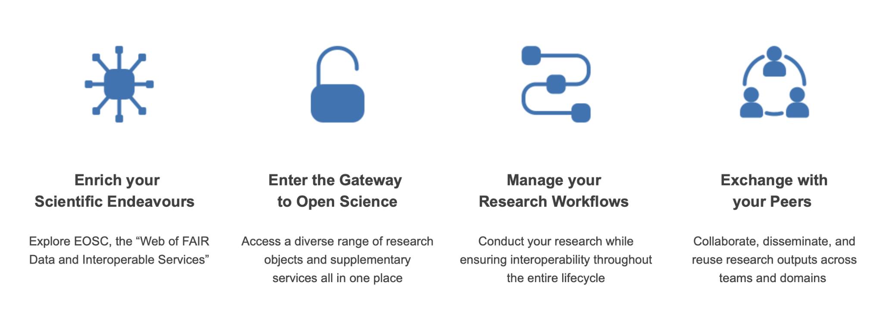
EOSC as the Data space for Research and Innovation
https://open-science-cloud.ec.europa.eu/

Slide 11
EXPLORING EOSC NODES AS PART OF THE EOSC FEDERATION
https://eosc.eu/wp-content/uploads/2023/11/20231112-Short-paper-on-the-EOSC-Federation-draft-v3.pdf
https://doi.org/10.5281/zenodo.10732049

Slide 12
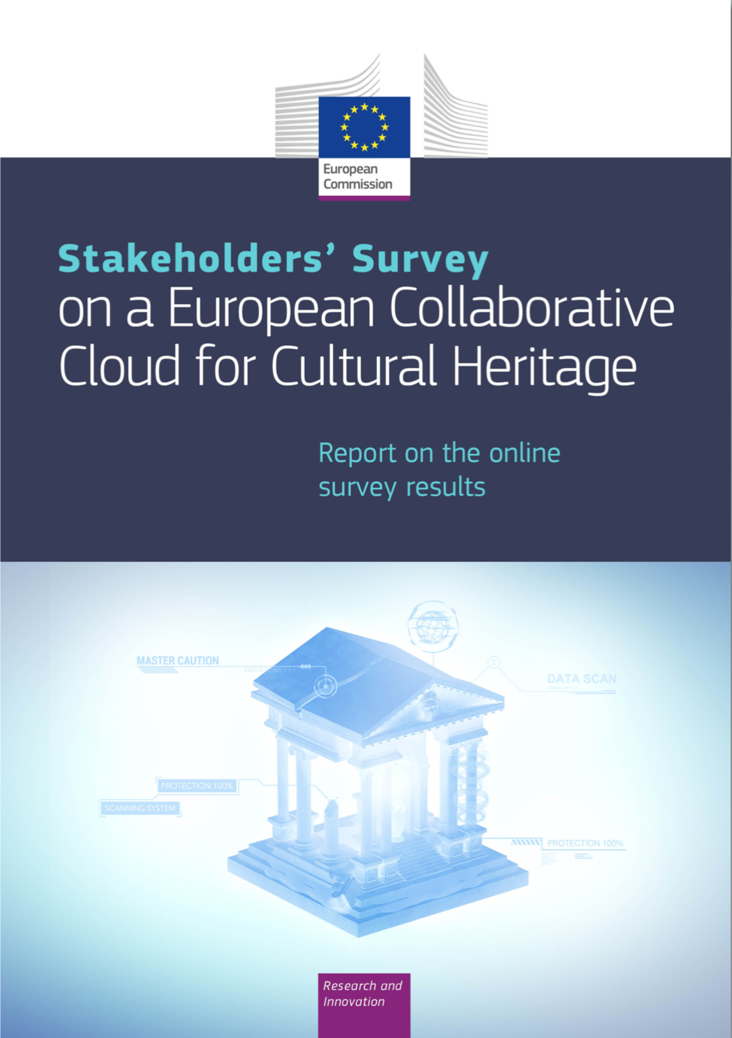
European Collaborative Cloud for Cultural Heritage (ECCCH)
European Commission, Directorate-General for Research and Innovation,Report on a European collaborative cloud for cultural heritage : ex – ante impact assessment, Publications Office of the European Union, 2022, https://data.europa.eu/doi/10.2777/64014
European Commission, Directorate-General for Research and Innovation, Stakeholders’ survey on a European collaborative cloud for cultural heritage: report on the online survey results, Publications Office of the European Union, 2022, https://data.europa.eu/doi/10.2777/691331
A European Collaborative Cloud for Cultural Heritage: HORIZON-CL2-2023-HERITAGE-ECCCH-01-01
Innovative tools for digitising cultural heritage objects: HORIZON-CL2-2023-HERITAGE-ECCCH-01-02
Notes:
Licence: Alexrk2 CC BY-SA 3.0
Europe’s national libraries are as varied and diverse as the nations whose memories they hold.
The Conference of European National Librarians (short ‘CENL’) is a network of 46 national libraries in 45 European countries and brings these great institutions together to celebrate and promote the importance of national libraries across the continent, creating opportunities to meet and work together to exchange knowledge, foster professional excellence and build mutual understanding.
Members of the CENL are national librarians of the member states of the Council of Europe.
Strategic plan
1 Support national libraries to increase their impact and to be strong organisations across a wide range of activities including; custodianship of collections, education, research, culture and heritage.
2 Develop national library services to meet the evolving needs of our diverse audiences including; the general public, learners, researchers and cultural visitors.
3 Develop as memory institutions to improve standards of stewardship and access to our physical and digital collections.
4 Strengthen CENL as a community in order to further support its members.
CENL Dialogue Forum: New format launched in March 2022
We are happy to announce the launch of a new format for CENL members to get in touch with other groups and stakeholders. The new CENL Dialogue Forum shall be an informal forum where CENL members can meet with representatives of other interest groups or organisations to discuss topics of mutual interest.

Slide 13
Defining strategic priorities
The aim of the Social Sciences and Humanities Open Cluster (SSHOC) is to transform the social sciences and humanities data landscape with its disciplinary silos and separate facilities into an integrated, cloud-based network of interconnected data infrastructures in the context of emerging European digital spaces and the European Open Science Cloud.
SSHOC Strategic Pillars
Sharing Data, Tools and Workflows (OSCARS WP2)
Training and Education (OSCARS WP1/3)
Advocacy and Outreach (OSCARS WP 3/1)

Slide 14
Understanding the role of the SSH Open Marketplace in the context of EOSC Federation
https://marketplace.sshopencloud.eu

Slide 15
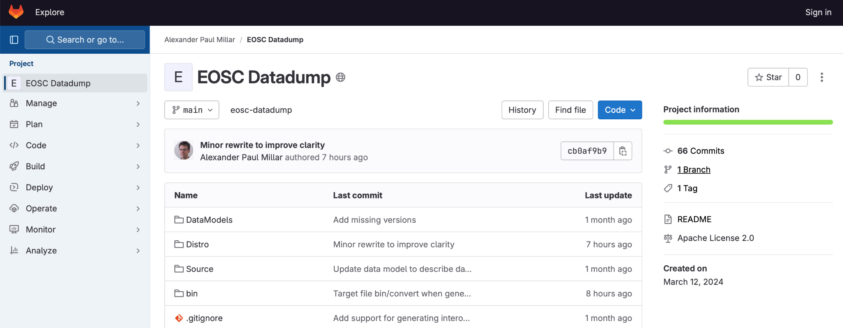
EOSC PROVIDERS AND THEIR RESOURCES - DATASET
https://gitlab.desy.de/paul.millar/eosc-datadump

Slide 16
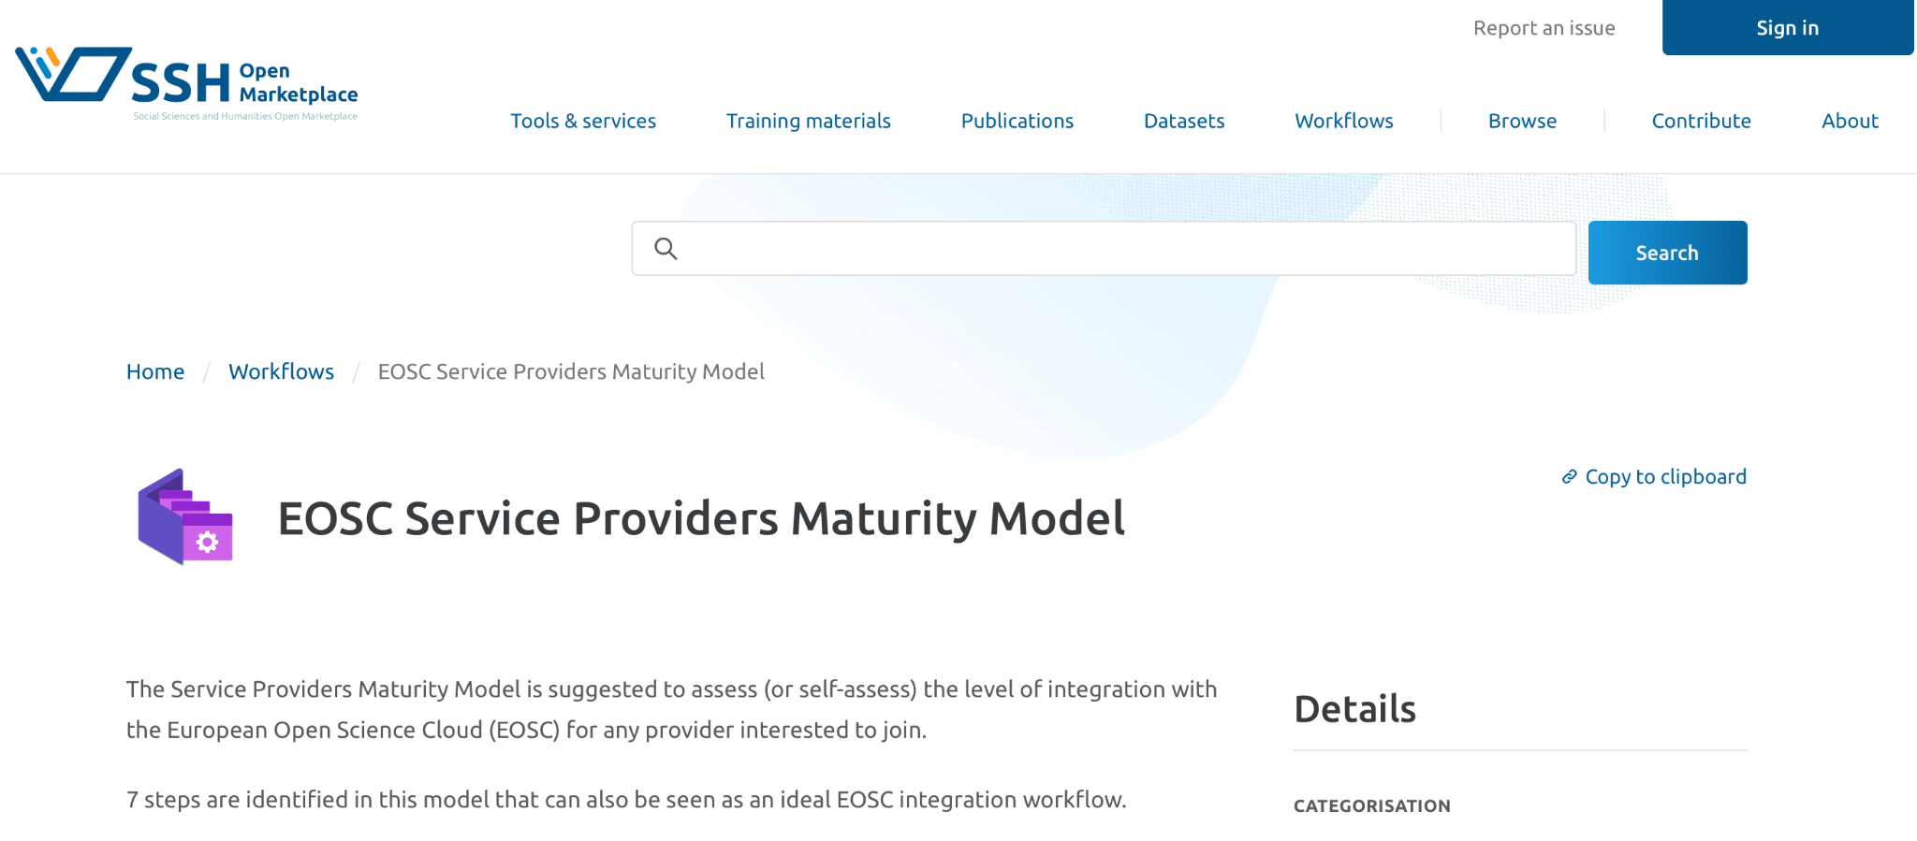
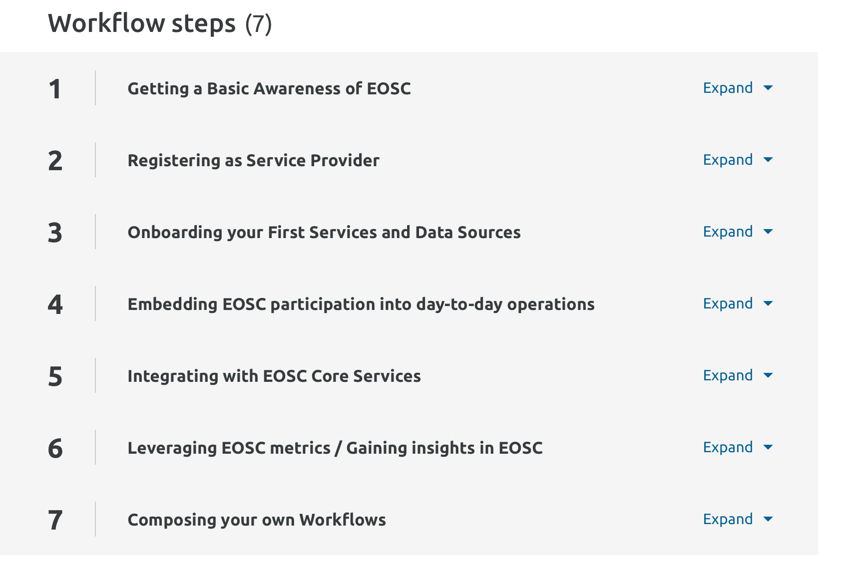
EOSC SERVICE PROVIDERS MATURITY MODEL
Sally Chambers, Laure Barbot, Martin Kirnbauer (2023)
EOSC Service Providers Maturity Model: https://marketplace.sshopencloud.eu/workflow/pig9Nt

Slide 17
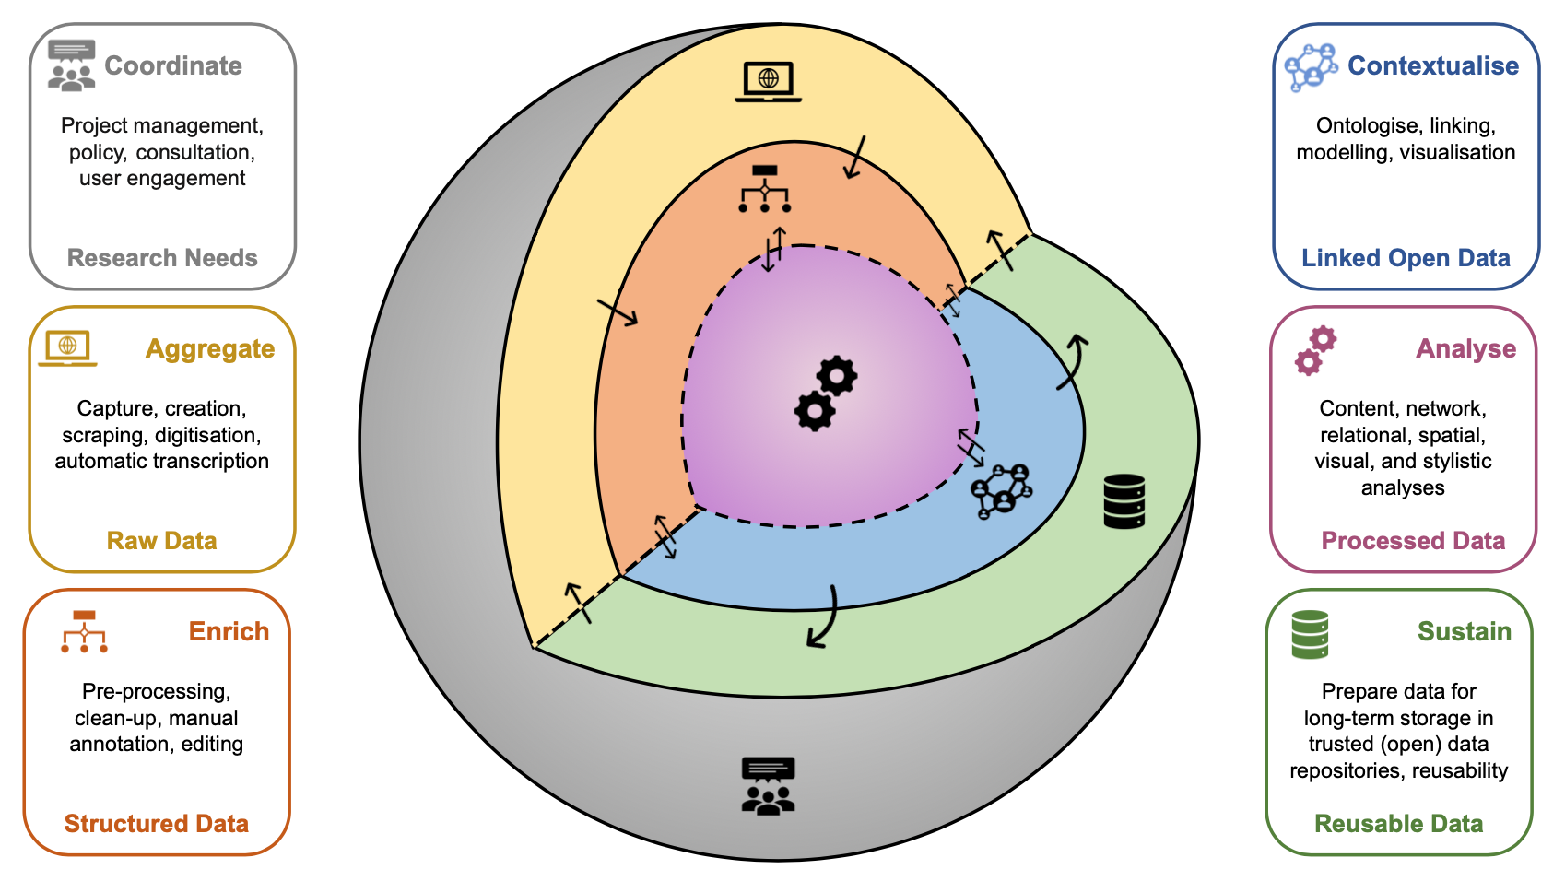
Embedding services into the Humanities Research Data Lifecycle
Notes:
Vergelijking met Google etc. Tailor made

Slide 18
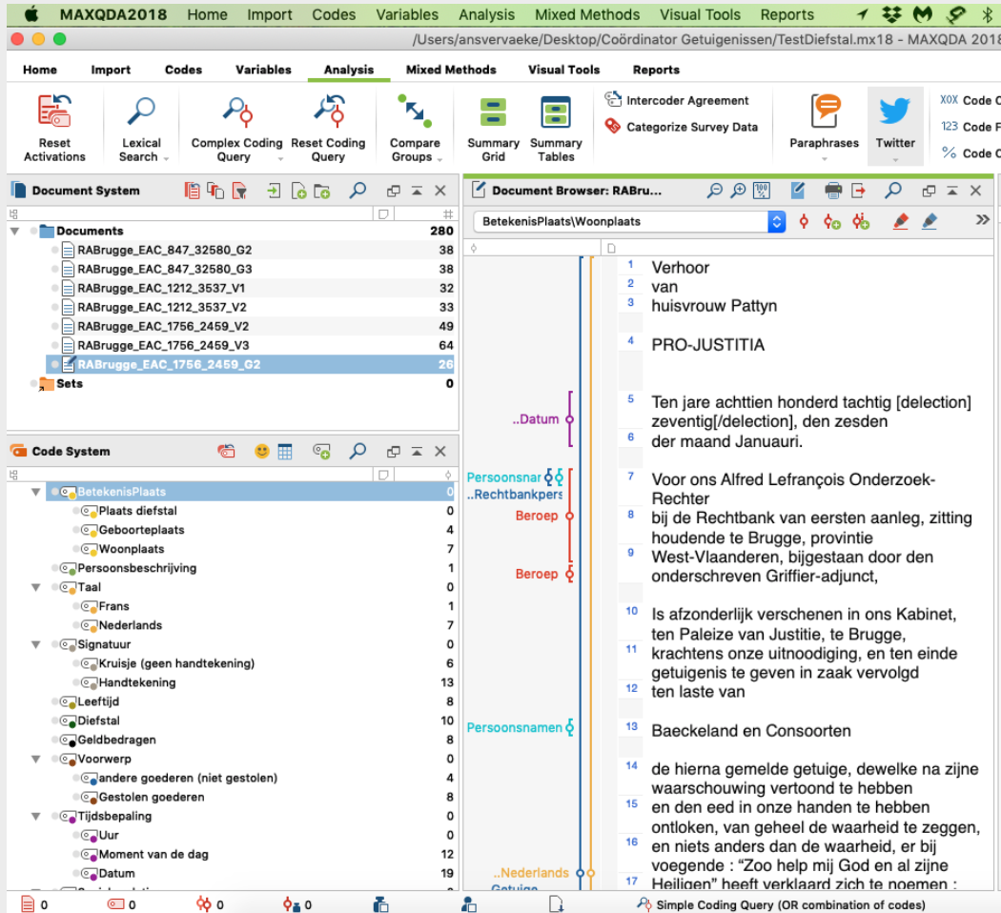
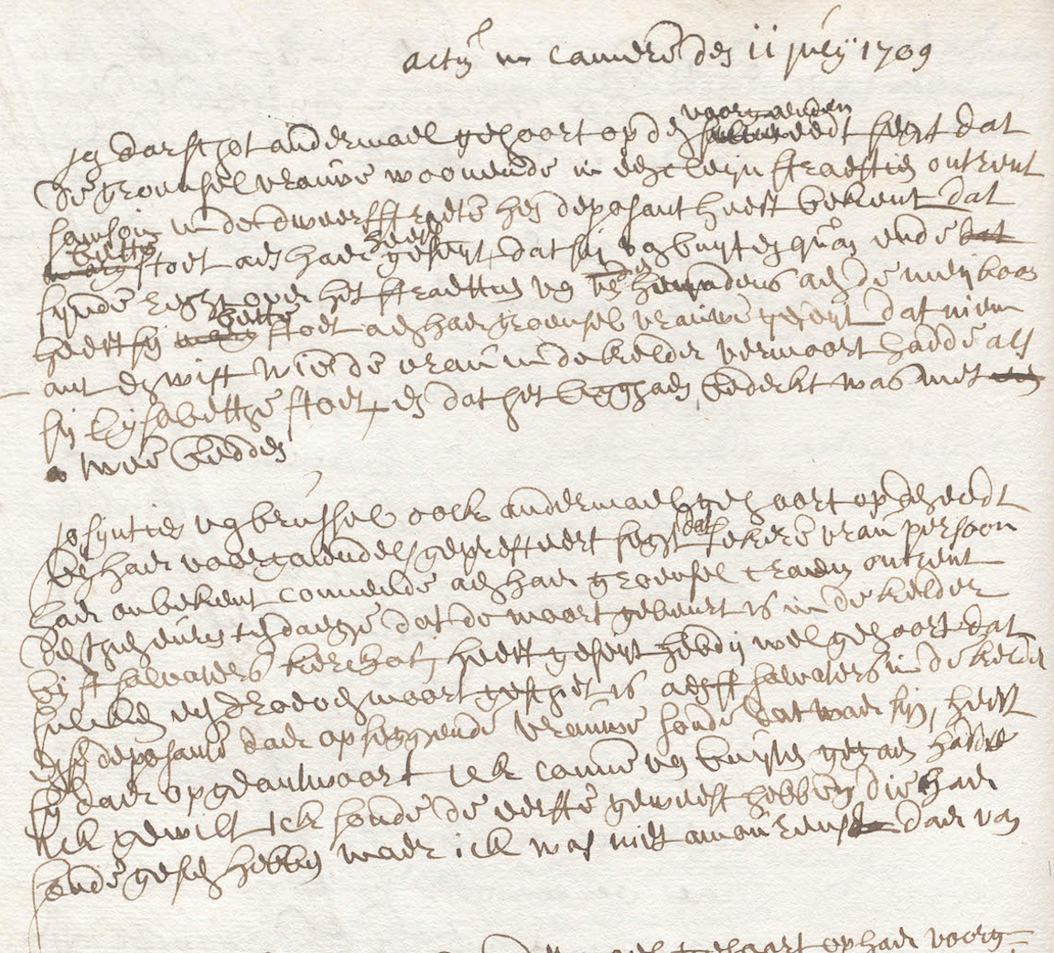
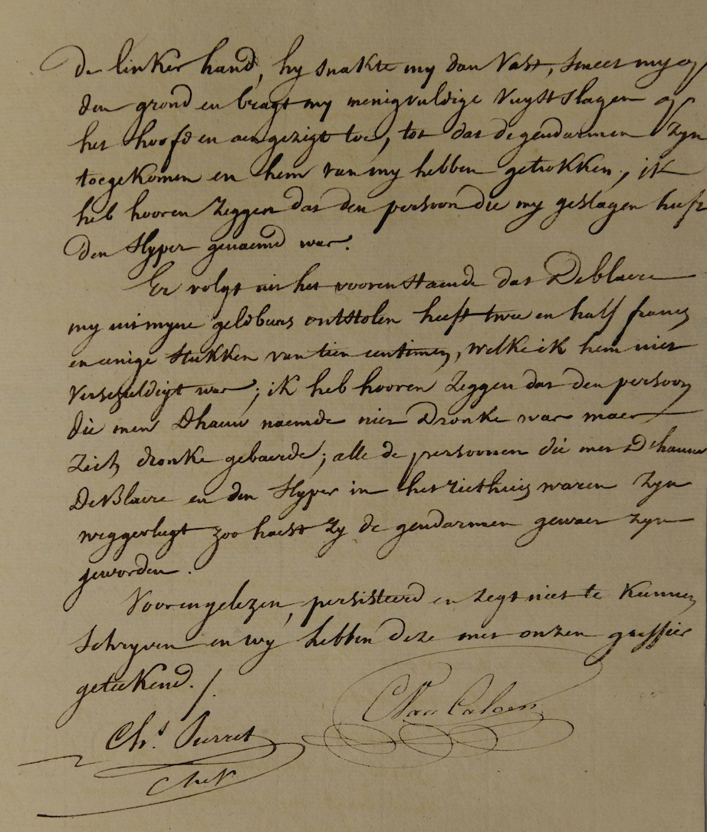
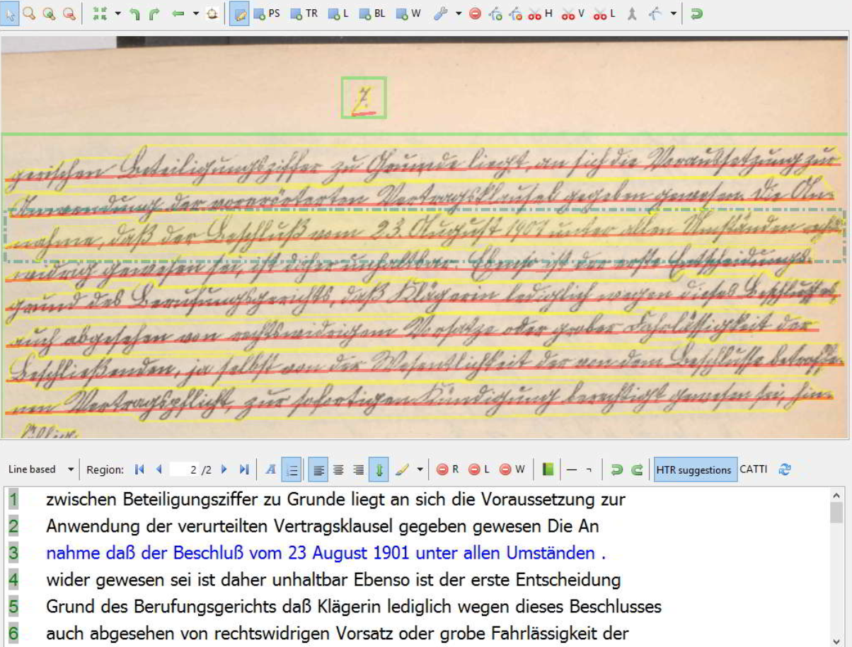
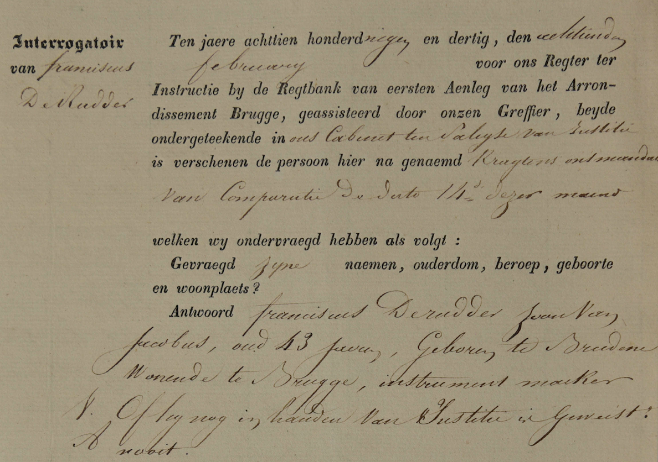
CLARIAH: enabling data-driven research in the humanities
Crowd-sourcing
IIIF Corpus Management Platform
Digital Text Analysis Pipeline
Named Entity Extraction
Social Network Analysis
Sentiment & Emotion Mining
Handwritten Text Recognition
Notes:
Excellent Research needs Excellent Research Infrastructures.
If the COVID-19 pandemic has taught our academic community anything, it is the extent to which the resilience of our research relies upon the development, sustainability, interoperability, and conscientious criticism of our digital tools, technologies, and methodologies. As our mobility is limited, and the digital research infrastructures that we have developed have been subjected to an unsolicited stress test, it becomes abundantly clear just how much we depend on them and how this need will only continue to grow in the future.

Slide 19
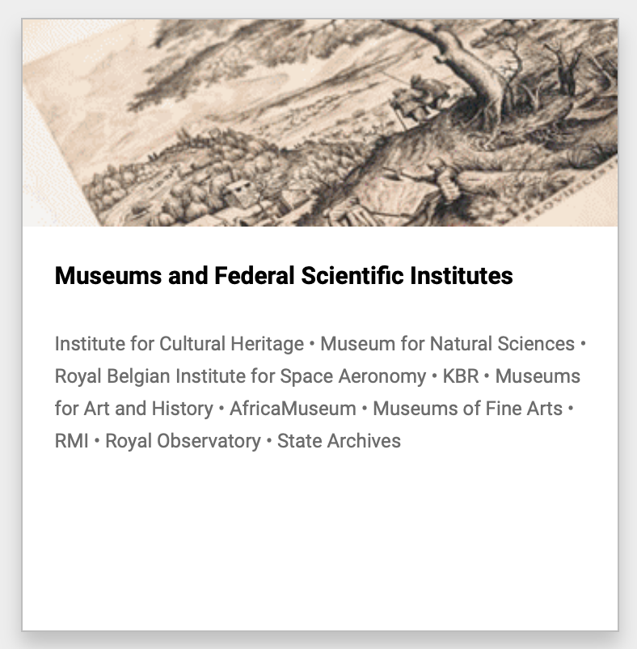
Towards a Federal Open Science Cloud (FedOSC)
Documentation
KBR, Royal Library of Belgium
State Archives of Belgium
Art
Royal Museums for Art and History
Royal Museums of Fine Arts of Belgium
Royal Institute for Cultural Heritage
Nature
Royal Belgian Institute of Natural Sciences
Royal Museum for Central Africa
Space
Royal Belgian Institute for Space Aeronomy
Royal Meteorological Institute of Belgium
Royal Observatory of Belgium and the Planetarium

Slide 20
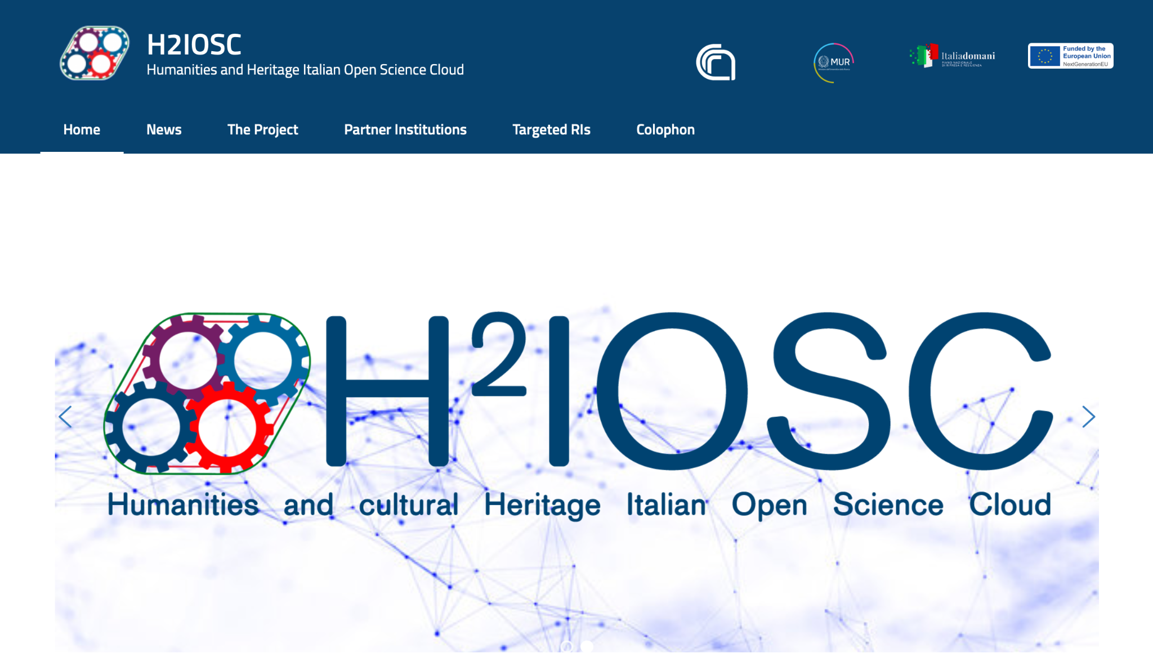
https://www.h2iosc.cnr.it/

Slide 21
SSHOC taking a strategic approach to this
increasingly complex landscape
Role: Interoperable Data Aggregation (beyond metadata)
Role: State of the Art processing of Cultural Heritage Data (e.g AI-based)
Role: Publishing of tools; methods and derived datasets for reuse

Slide 22
Thanks very much for your attention!
sally.chambers@dariah.eu

